Slide 1


What is a Computer?
A computer is an electronic machine that helps you do tasks quickly and easily. It can store information, process data, and perform calculations. Think of it as a smart helper that can do many things, like writing, drawing, playing games, or even solving math problems.
by Ram N Java

Slide 2



What Can a Computer Do?
Store Information
A computer can save data like photos, videos, documents, and music.
Example: You can save your school projects on a computer.
Process Data
It can take input (like numbers or words), work on it, and give you output (like results or answers).
Example: You type a letter, and the computer shows it on the screen.

Slide 3
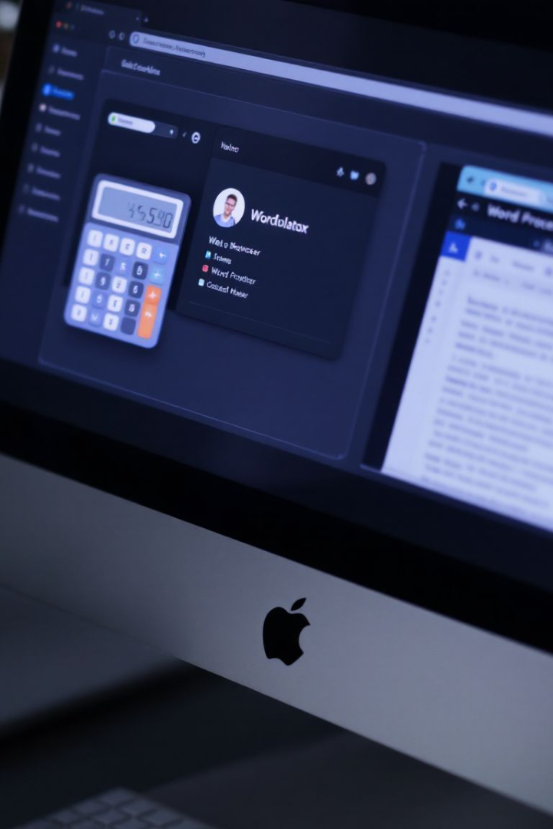
What Can a Computer Do?
Perform Calculations
Connect to the Internet
A computer can solve math problems very fast.
A computer lets you browse the web, send emails, and watch videos online.
Example: It can add, subtract, or even solve complex equations.
Example: You can search for information or chat with friends.
Run Programs
A computer can run software or apps to do specific tasks.
Example: You can use a word processor to write or a game to play.

Slide 4
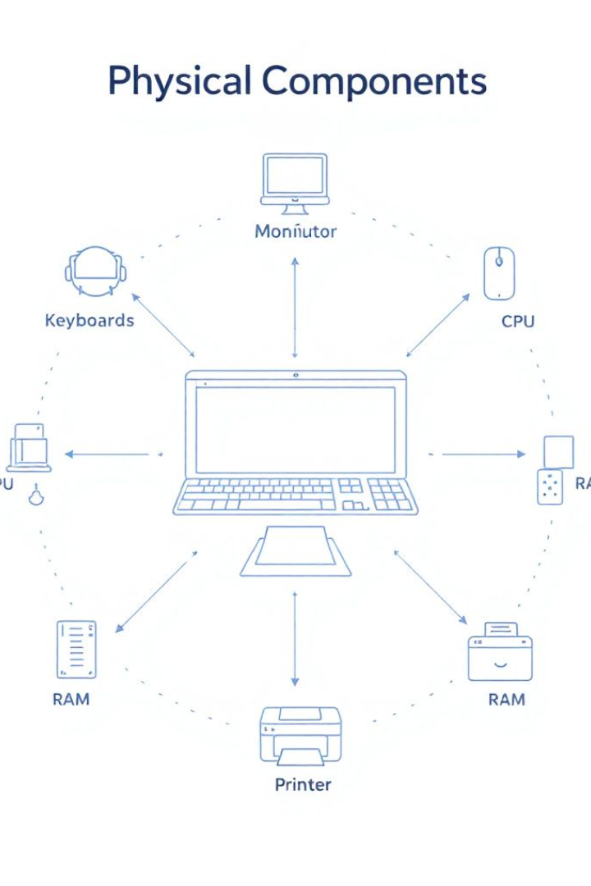
Main Parts of a Computer
Monitor
The screen that shows you everything.
Keyboard
Used to type letters and numbers.
Mouse
Used to move the cursor and click on things.
CPU
The brain of the computer that does all the thinking.
RAM
Helps the computer run fast by temporarily storing data.
Storage
Saves all the files, apps, and operating system.
Printer
Prints documents or pictures on paper.
These are the physical parts of the computer that you can touch.

Slide 5
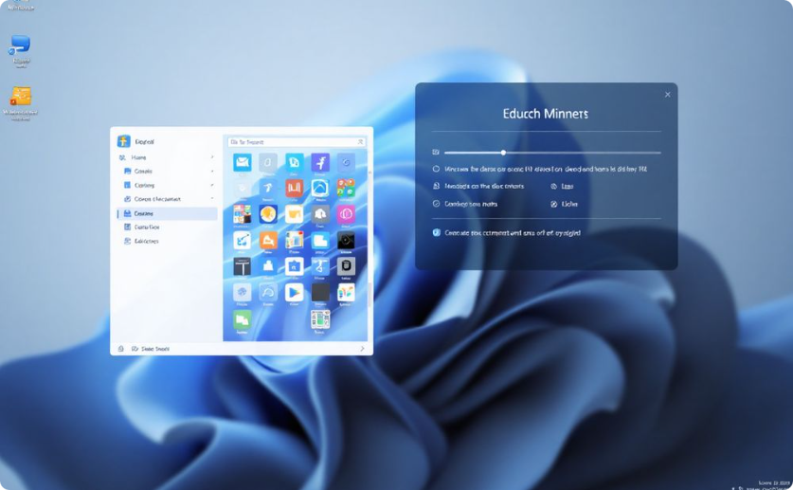
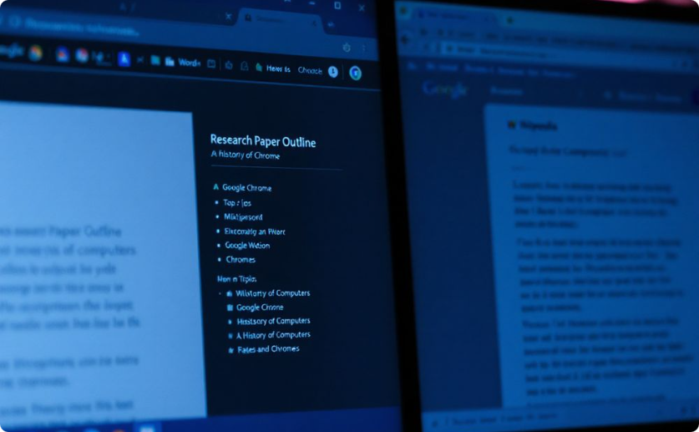
Main Parts of a Computer
Operating System (OS)
Apps
Like Windows or macOS, it helps the computer run.
Like Microsoft Word for writing or Chrome for browsing the internet.
These are the programs or instructions that tell the computer what to do.

Slide 6




How Does a Computer Work?
Input
You give the computer data or commands using input devices like a keyboard or mouse.
Processing
The computer's CPU processes the input and follows the instructions.
Output
The computer gives you the result through output devices like a monitor or printer.
Storage
The computer saves the data in its memory or storage devices like a hard drive.

Slide 7





Why is a Computer Useful?
Saves Time
A computer can do tasks much faster than humans.
Stores Lots of Information
You can save thousands of files, like photos, videos, and documents.
Helps with Learning
You can use a computer to study, research, or take online classes.
Connects People
A computer lets you talk to friends and family through email, video calls, or social media.
Entertainment
You can watch movies, play games, or listen to music on a computer.

Slide 8
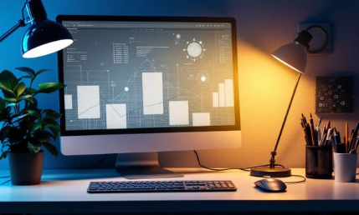

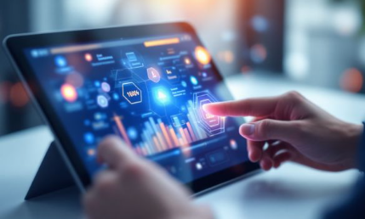
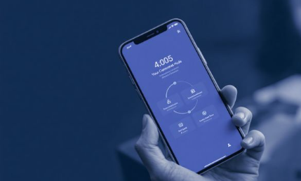

Types of Computers
1
Desktop Computer
2
Laptop
3
Tablet
4
Smartphone
Used at homes and offices.
A portable computer that can be carried anywhere.
A small touchscreen
computer.
A pocket-sized computer with calling features.
5
Supercomputer
A very powerful computer used for big calculations.

Slide 9


Summary
Electronic Machine
1
A powerful tool that makes life easier
Hardware & Software
Physical parts and programs working together
Versatile Helper
Can do almost anything you need
A computer is an electronic machine that helps you store information, process data, and perform tasks quickly. It has hardware (physical parts) and software (programs) that work together to make your life easier. Whether you're writing, playing games, or browsing the internet, a computer is a powerful tool that can do almost anything you need!

